Slide 1
Presented by : Aashiq Ahmed A Sukesan EG Vengadesh J
Rover with Lidar Navigation and Virtual Phenotyping Sensors
AGRI-SCOUT
Guided by : Dr. Kingston Stanley

Slide 2
INTRODUCTION
The Concept : An Autonomous 6WD rover that navigates between crop rows to monitor plant health.
Core Innovation : Replacing expensive industrial sensors with "Virtual Sensors" using Computer Vision and Signal Processing algorithms.
Goal : To provide early warning for Nitrogen deficiency, Water stress, and Disease risk without human intervention.

Slide 3
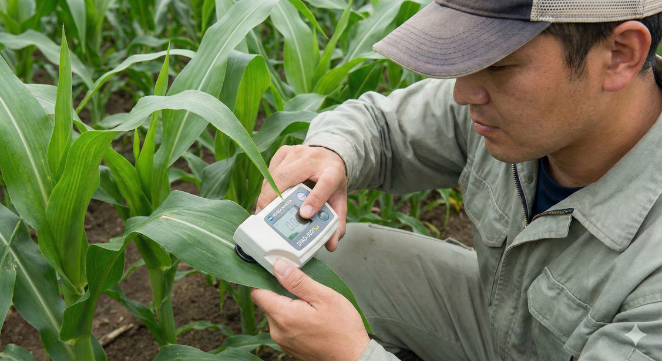
PROBLEM STATEMENT
Limitations of Manual Scouting:
Subjectivity : Human visual inspection is prone to error and fatigue.
Scale : Impossible to inspect 300,000+ plants in a 10-acre field manually.
Latency : Visual symptoms (yellowing/wilting) often appear only after 30% of yield is lost.
High Cost of Existing Technology:
Nitrogen Meter (SPAD-502) : ~₹2,00,000 ( For nitrogen estimation )
Pressure Chamber : ~₹2,50,000 ( For water stress estimation )
RTK-GPS Systems : ~₹4,00,000 ( For navigation )
Gap : Small-scale farmers need a low-cost, automated solution.

Slide 4
PROPOSED SOLUTION
Platform : 6WD Off-Road Autonomous Rover.
Navigation : LiDAR-based "Tunnel Navigation" (GPS-free).
Sensing approach : Non-Invasive Virtual Phenotyping - Instead of chemical analysis, we use Optical & Geometric Analysis.
Key Parameters Monitored :
Nitrogen Levels (via Color Indexing)
Water Stress/Wilting (via Leaf Angle Geometry)
Disease Risk (via Thermodynamic VPD Calculation)

Slide 5
HARDWARE COMPONENTS
Category | Component Name | Specification / Model | Qty | Function in Project
Core Computing | Main Computer | Raspberry Pi 5 (8GB RAM) | 1 | The "Brain." Runs Python, OpenCV vision algorithms, and LiDAR navigation logic.
 | Storage | MicroSD Card (32GB, Class 10) | 1 | Stores the Raspberry Pi OS, your code, and logged data/images.
Sensors (Inputs) | Primary Navigation | YD Lidar T-mini Plus | 1 | Scans crop rows to create a 2D map for "tunnel navigation" without GPS.
 | Visual Sensor | Raspberry Pi Camera Module V3 | 1 | Captures images for "Virtual Nitrogen" (Color) and "Wilting" (Angle) analysis.
 | Stability Sensor | MPU6050 | 1 | Provides heading data (Yaw) to correct driving errors on slippery mud.
 | Climate Sensor | DHT22 | 1 | Measures air data to calculate Vapor Pressure Deficit (VPD) for disease risk.
Mechanical & Motion | Drive Actuators | High-Torque DC Geared Motors | 6 | Provides the necessary torque to drive the robot through rough agricultural soil.
 | Traction System | Off-Road Rubber Tyres | 6 | Ensures high grip on loose mud and field furrows.
 | Suspension | Spring-Loaded Struts | 6 | Absorbs vibrations from uneven terrain to keep the LiDAR and Camera stable.
 | Structural Frame | Aluminum Alloy Base & Top Plate | 1 Set | The main load-bearing structure that holds the electronics and battery.
 | Motor Drivers | BTS7960 | 2 | Handles high current from battery to drive the motors. (1 for Left side, 1 for Right side).

Slide 6
VIRTUAL SENSORS METHODOLOGY
Virtual Sensor Algorithms
Virtual Nitrogen Sensor (Color Analysis):
Algorithm : DGCI (Dark Green Color Index).
Logic : Converts RGB to HSB color space. A lower DGCI score correlates to Nitrogen deficiency (Chlorosis).
Virtual Wilting Sensor (Geometric Analysis):
Algorithm : Canny Edge Detection + Hough Transform.
Logic : Calculates the angle of leaf veins relative to the stem. Drooping angles (<45°) indicate turgor pressure loss (Wilting).
Virtual Disease Sensor (Thermodynamics):
Algorithm : Vapor Pressure Deficit (VPD) Calculation.
Logic : Uses Temp/Humidity to calculate air saturation. Low VPD (<0.4 kPa) predicts fungal outbreak risk. VPD = VP{sat} - VP{act}

Slide 7
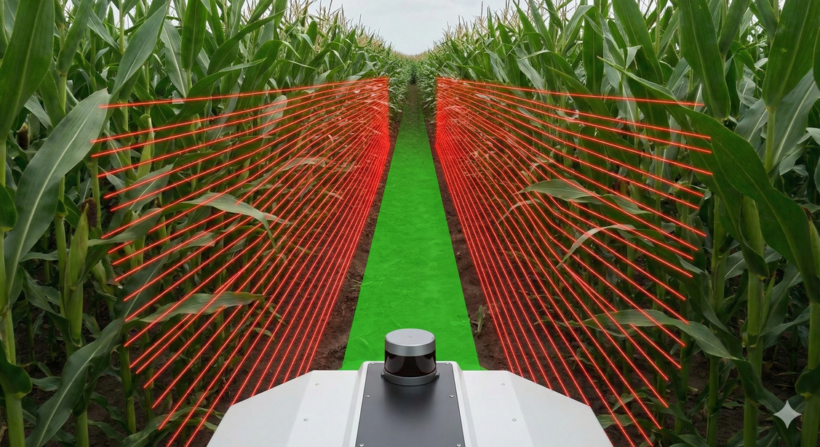
NAVIGATION METHODOLOGY
Autonomous Navigation Strategy
Technique : LiDAR Tunneling (Row Following).
Sensor Fusion : LiDAR + MPU6050 Gyroscope.
Control Logic :
LiDAR: Measures distance to Left (d_L) and Right (d_R) crop rows.
PID Controller: Corrects steering based on Error (E = d_R - d_L)
Gyroscope: Provides "Heading Lock" to prevent twisting on slippery mud.
Auto-Stop Feature : Detects "Infinite Width" at the end of the row to stop the robot automatically.

Slide 8
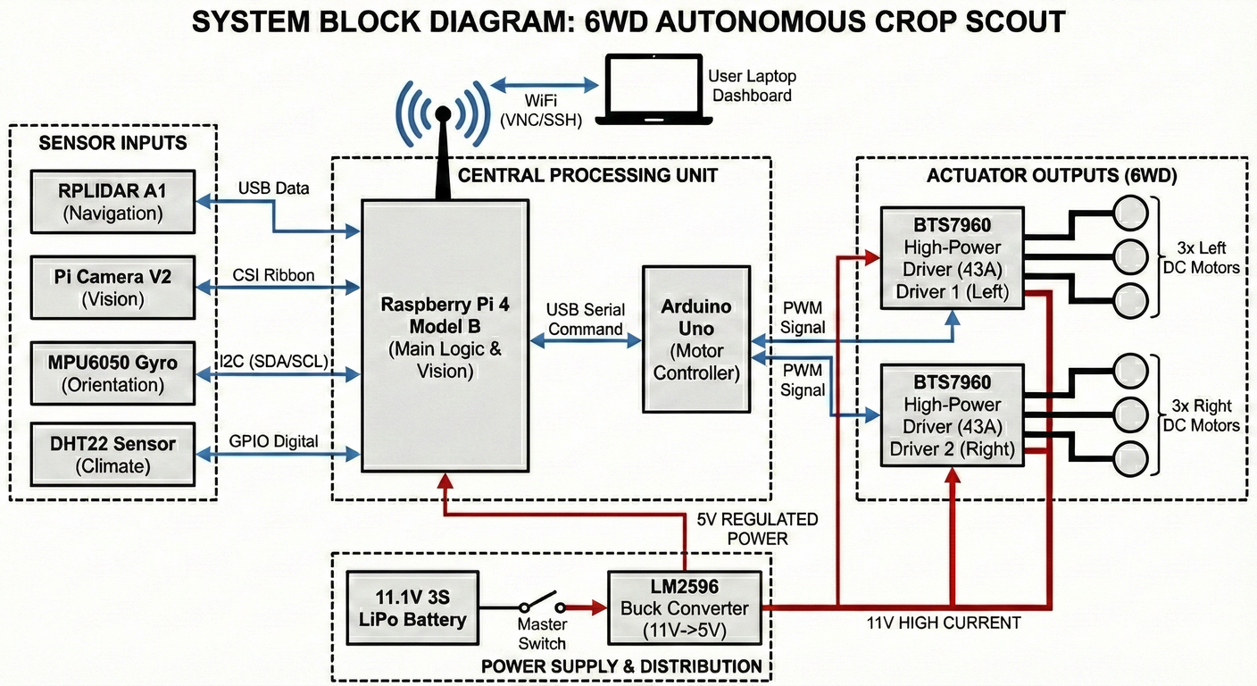
BLOCK DIAGRAM

Slide 9
ADVANTAGES
01
02
03
95% Cost Reduction
The Advantage : Replaces expensive industrial sensors with smart software algorithms running on low-cost hardware.
Why it matters : Makes precision agriculture technology affordable for small-scale Indian farmers.
GPS-Free "Tunnel" Navigation
The Advantage: Unlike drones or tractors that rely on satellite signals (which get blocked by trees), this robot uses LiDAR to see crop rows as physical walls.
Why it matters: It can navigate autonomously under dense crop canopies and in remote areas where GPS signals are weak or unavailable.
Non-Destructive "Virtual" Sensing
The Advantage : Uses Computer Vision (Camera) to measure plant health (Nitrogen & Wilting) without touching or cutting the leaves.
Why it matters : It provides early warning of stress before visible damage occurs, without harming the crop or requiring lab work.

Slide 10



OUR TEAM
Aashiq Ahmed A
Sukesan EG
Vengadesh J

Slide 11
THANK YOU

